Slide 1
Delivery Partner Strategy Assignment Case Study Analysis
Prepared By
Abhijeet Kedar
Tools Used :
Microsoft Excel
Pivot Tables
KPI Analysis
Data Visualization
Abhijeet Kedar

Slide 2
Project Overview
Project Overview :
This project focused on improving delivery partner performance and operational efficiency through two key initiatives:
Part 1
Design a cost-effective benefit program to encourage higher partner participation and supply hours.
Part 2
Develop a Partner Quality Evaluation Framework to identify underperforming partners and recommend retraining actions.
Business Goals :
Improve partner availability
Control incentive costs
Enhance service quality
Support data-driven decision making
Abhijeet Kedar

Slide 3
Business Objectives
Objective 1 :
Design an incentive program that:
Encourages higher supply hours
Rewards participation on priority days
Maintains CPT below ₹0.90
Objective 2 :
Develop a quality evaluation framework that:
Measures partner performance
Identifies improvement opportunities
Supports retraining decisions
Abhijeet Kedar

Slide 4
Dataset Overview
Part 1 Dataset :
Partner ID
Date
Supply Hours
Tasks Completed
Part 2 Dataset :
Acceptance Rate
Cancellation Rate
Tasks Not Delivered
Partner Cancellation
Task Time
Customer Rating
Analysis Tool :
Microsoft Excel
Abhijeet Kedar

Slide 5
Part 1 Methodology
Benefit Program Design
Framework
Supply-hour buckets
Base reward points
Priority-day multipliers
Incentive cost calculation
CPT evaluation
Objective
Increase partner participation while maintaining cost efficiency.
Abhijeet Kedar

Slide 6
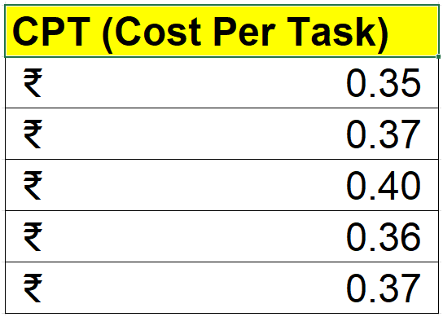
Part 1 Results
Incentive Program Performance
Key Results :
Target CPT - ₹0.90
Actual CPT - ₹0.37
Status - Target Achieved
Key Finding :
The proposed incentive model remained significantly below the maximum CPT threshold while encouraging higher partner participation.
Abhijeet Kedar

Slide 7
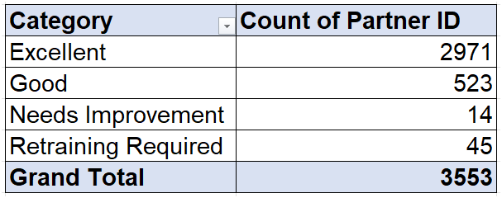
Part 2 Methodology
Partner Quality Evaluation Framework
Performance Metrics
Acceptance Rate
Cancellation Rate
Tasks Not Delivered
Partner Cancellation
Task Time
Customer Rating
Evaluation Process
Weighted Quality Score → Performance Classification
Abhijeet Kedar

Slide 8
Partner Performance Summary
Total Partners Evaluated - 3,553
Excellent - 2,971
Good - 523
Needs Improvement - 14
Retraining Required - 45
Abhijeet Kedar

Slide 9
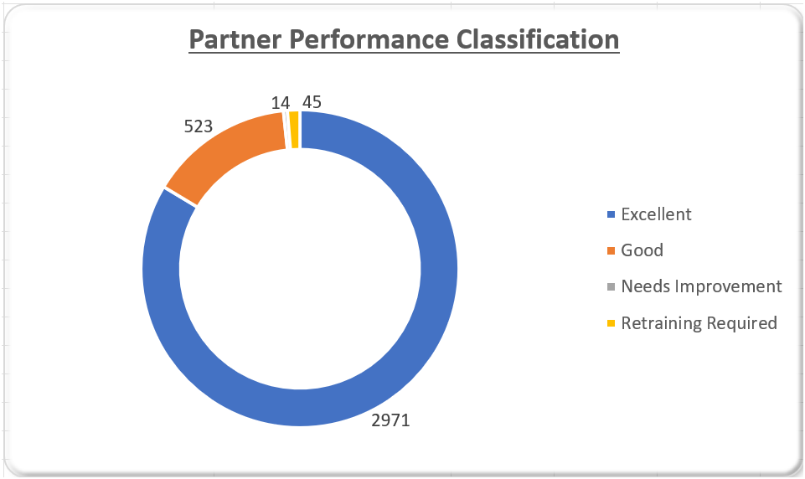
Partner Performance Classification
Key Observation :
Approximately 84% of delivery partners were classified as Excellent performers, demonstrating strong overall network performance.
Abhijeet Kedar

Slide 10
Key Business Insights
Insight 1
The incentive framework achieved a CPT of ₹0.37, well below the target threshold.
Insight 2
The majority of delivery partners demonstrated excellent performance.
Insight 3
Only 59 partners require coaching or retraining.
Insight 4
Targeted improvement initiatives can enhance service quality while minimizing operational costs.
Abhijeet Kedar

Slide 11
Recommendations
Incentive Program :
Implement the proposed reward framework.
Continue monitoring CPT.
Quality Framework :
Recognize high-performing partners.
Provide coaching for moderate performers.
Conduct mandatory retraining for low performers.
Abhijeet Kedar

Slide 12
Conclusion
The analysis successfully addressed both business objectives by developing a cost-efficient incentive program and a structured Partner Quality Evaluation Framework.
The proposed solutions support:
Improved partner engagement
Enhanced service quality
Better operational efficiency
Sustainable business growth
Thank You
Prepared By Abhijeet Kedar
Abhijeet Kedar

